Slide 1



Spectral Efficiency of MU-Massive MIMO System for Perfect and Imperfect CSI Condition
Ika Rohmatul Aini, Puji Handayani
Electrical Engineering Dept.
Institut Teknologi Sepuluh Nopember
Notes:
Hello Everyone, Thank you for joining me here, I am Ika Rohmatul Aini from Electrical Eng Dept Institut Teknologi Sepuluh Nopember. I’m here today to talk to you about my research presenatation. The title is….
22st ISITIA, July, 21-22, 2021

Slide 2

GENERAL STRUCTURES
Introduction
Channel Model
System Model
Numerical Results
Conclusion

Slide 3
INTRODUCTION

Slide 4
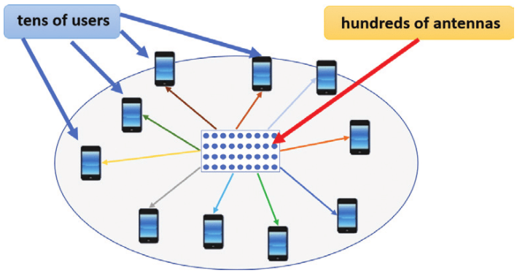
What is massive mimo
Massive MIMO sytem is a system that hundreds antennas on a BS serve tens of users simulatneously

Slide 5
what we proposed
Channel estimation process will be very complex because it is proportional to the large number of BS antennas
Some previous research on Massive MIMO system assumed perfect CSI condition on both the BS and the user side.
In practical, there is no perfect CSI condition, because the BS needs to estimate the channel response at certain coherence interval.
This research focus to investigate:
  Spectral efficiency of Massive MIMO system when the channel estimation process exists.
  MUI eliminination using linear precoding techniques, such as MRT, ZF and MMSE

Slide 6
CHANNEL MODEL

Slide 7
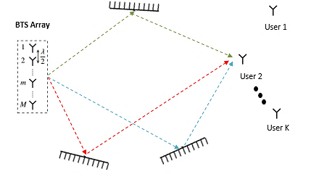
FREQUENCY-SELECTIVE RAYLEIGH
There are many scatterers and there is no line of sight path.
Consist of L tapped-delay line channel.

Slide 8
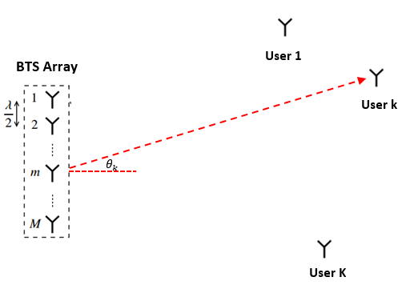
UNIFORMLY RANDOM LINE OF SIGHT (UR-LOS)
Users and BS are in line of sight position and there is no scatterer.
BS uses ULA antenna configuration.
User position is random and has uniform distribution.

Slide 9
SYSTEM MODEL

Slide 10
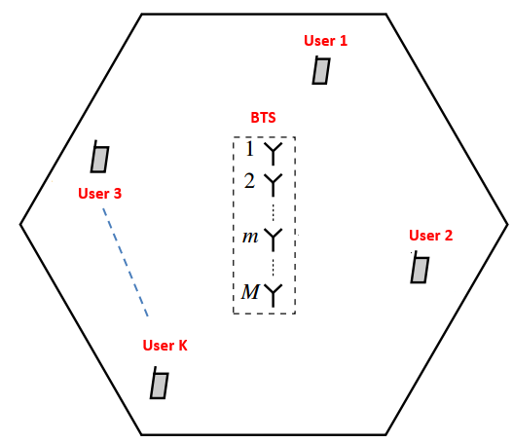
SYSTEM MODEL
The single cell system consists of a BS equipped with M number of antennas, and serves K users.
The number of BS antennas is much larger than the number of users .
Using TDD for uplink and downlink transmission scheme.
Channel estimation process is only needed on the BS side, because the channel response of TDD scheme is reciprocal.

Slide 11
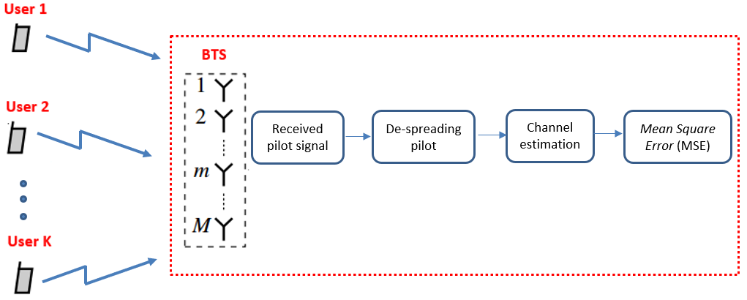
Channel estimation
Each user transmits orthogonal pilot signal to the BS at each coherence interval.
BS estimates the channel response using Minimum Mean Square Error (MMSE) technique.

Slide 12
NUMERICAL RESULTS

Slide 13
Bit error rate ON THE FREQ- SELECTIVE RAYLEIGH CHANNEL
BER of Singe Input Single Output (SISO) and Single User Massive MIMO
Overall, BER of Massive MIMO system is lower than SISO.
All of precoding schemes yield the same BER, because there is no multiuser interference.

Slide 14
Bit error rate ON THE FREQ- SELECTIVE RAYLEIGH CHANNEL (CONT…)
BER of Singe Input Single Output (SISO) and Multi User Massive MIMO
Several users which are served simultaneously will cause multiuser interference.
All precoding schemes have different performance due to the effects of multiuser interference.
For MU Massive MIMO system, ZF and MMSE yield the lower BER than MRT.

Slide 15
Bit error rate ON THE UR-LOS CHANNEL
All precoding scheme provide same BER under the UR-LOS channel.

Slide 16
SPECTRAL EFFICIENCY OF MU-MASSIVE MIMO ON PERFECT CSI CONDITION
K = 30 users, downlink SNR = 10dB
There is no channel estimation process in BS.
BS is fully knowing the channel information without any noise and pilot contamination effects.
ZF and MMSE precoding yield the same spectral efficiency both at Rayleigh and UR-LOS channel.
Spectral efficiency at UR-LOS channel is higher than Rayleigh.

Slide 17
SPECTRAL EFFICIENCY OF MU-MASSIVE MIMO ON imPERFECT CSI CONDITION
Downlink SNR =10 dB, uplink SNR = -5 dB.
Each user transmit a minimum number of pilot sequences, which are 30 symbols.
BS estimates channel response from pilot signal transmitted by users
The spectral efficiency of imperfect CSI condition is lower than perfect CSI condition due to the channel estimation error.

Slide 18
Spectral efficiency vs. number of users
The sum SE will increase as the number of users increases on condition that the number of users is still smaller than the number of BS antennas (𝐾<𝑀).
Notes:
At 100 fixed number of BS antennas, spectral efficiency continues to increase because the number of users is still smaller than the number of BS antennas.
when the number of BS antennas is 30 and serves exceeds 30 users, then the SE started to decrease due to the high interference between users, and precoding is not able to overcome it.
22st ISITIA, July, 21-22, 2021

Slide 19
conclusion
The spectral efficiency increases significantly as the number of BS antennas increases.
ZF and MMSE precoding work better than MRT precoding in miminizing MUI.
Under imperfect CSI condition, channel estimation error is getting bigger at low uplink SNR, so that the spectral efficiency will decrease.
The spectral efficiency of each user will decrease if the number of users increases, because the MUI is getting bigger.

Slide 20
THANK YOU

